Slide 1
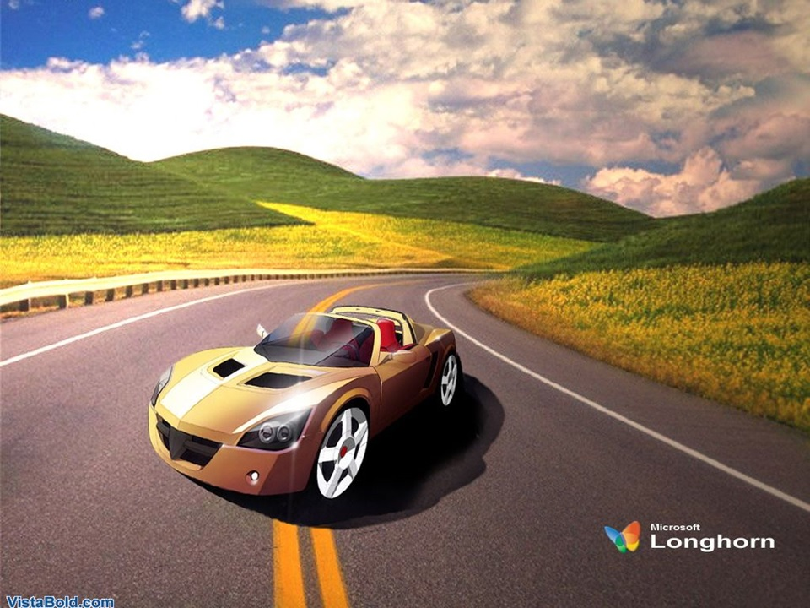
WELCOME
Notes:
The Car moving on the wheels running quickly.

Slide 2
Identity
Sheikh Tajuddin Ahmed.
Senior Teacher
Hazi Ayet Ali Bhuiyan High School Khadun, Rupsi,Rupgonj, Narayangonj.
Presentation for class -8
Unit-9
Lesson=1-5
Time= 50 minutes
Things that have changed our life

Slide 3
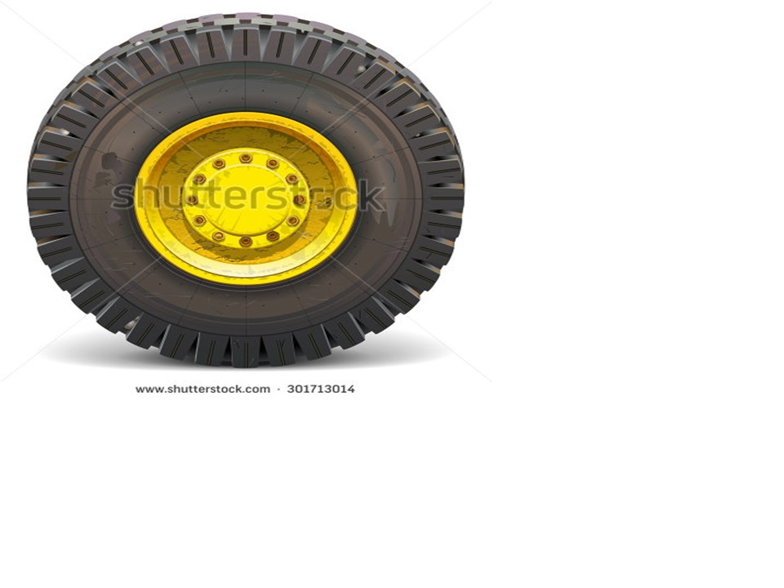
Look at the picture and Say what’s it?
The Picture is wheel. It’s Changed Our Life

Slide 4
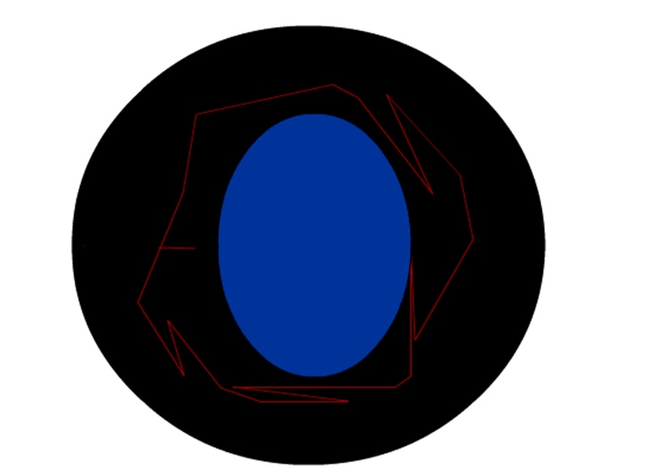
Look at the picture
What is it?
Notes:
It is Wheel

Slide 5
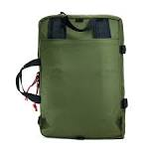
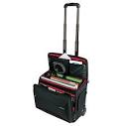
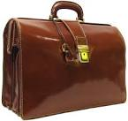
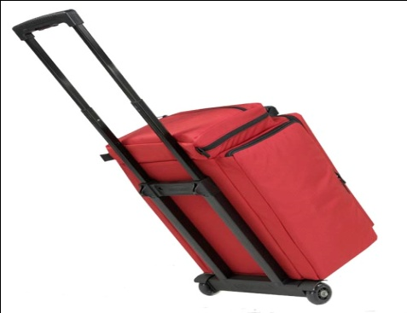
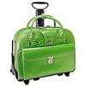
So,Today’s Our Lesson is “The Wheel”
Look at the pictures and say which one is easier to move and why.
It’s move easily
It’s can’t move easily

Slide 6
Learning outcomes
After we studied unit, we will be able to
Ask and answer questions
Participate in short dialogues and conversations on familiar topics
Read aloud texts with proper sounds, stress and intonation
Read and understand text materials
Write answers to questions
Write short paragraphs

Slide 7
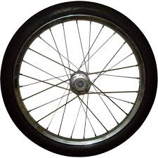
The history of the wheel
Look at the following pictures of wheels. They existed in different ages in history. Do you know which wheels are ‘first, second, etc.
First
SEcond

Slide 8
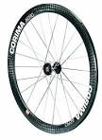
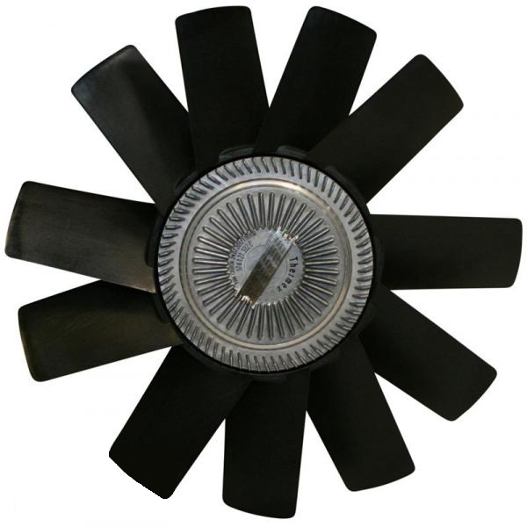
Third
Fourth
Fifth

Slide 9
Read the statements below and say whether they are true or false. If false, give the right answer.
The Greeks were the pioneers in developing spoked-wheels.
The earliest wheel was discovered in 2000 B.C.
The Egyptians first used wheels on chariots.
The Romans first used wheeled chariots for warfare.
The ancient Indians used wheels before the ancient Romans did.
False
Fales
True
false
True

Slide 10
Look at the following map of ancient river-valley civilizations and discuss their locations in the map with your partner.
S1 : Where was Mesopotamia?
S2 : It was situated in ancient Iraq along the valley of the rivers Tigris and Euphrates.
S1 : Why is it famous?
S2 : The oldest wheel was discovered there.
S1 : Were is Egypt ?
S2 : Egypt is situated by the side of the Nile.
S1 : When did they use the wheels on chariots?
S2 : They used the wheels on chariots around 2000 B. C.
S1 : Thank you.
Notes:
Mesopotamia means by Irag. And Egypt means Meshor situated by the side of the Nile.

Slide 11
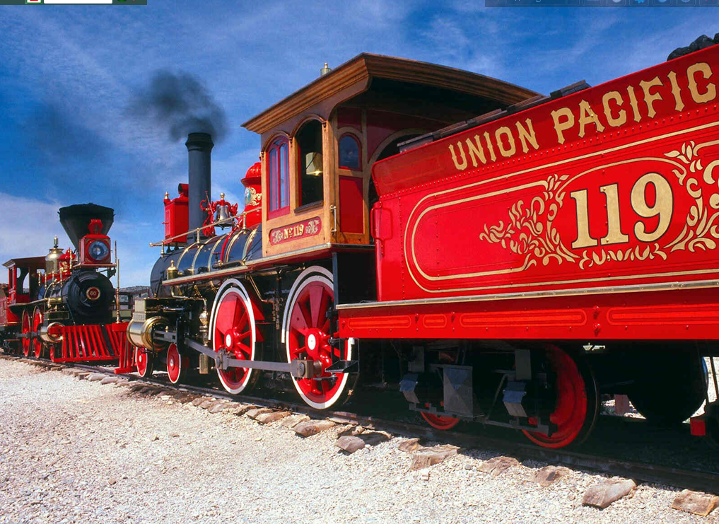
The oldest wheels on the earth of Train

Slide 12
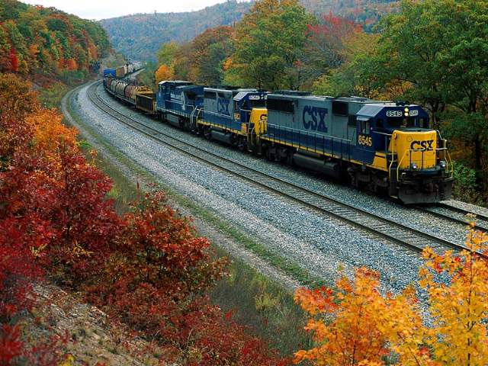
The Modern wheels of Train on the earth

Slide 13
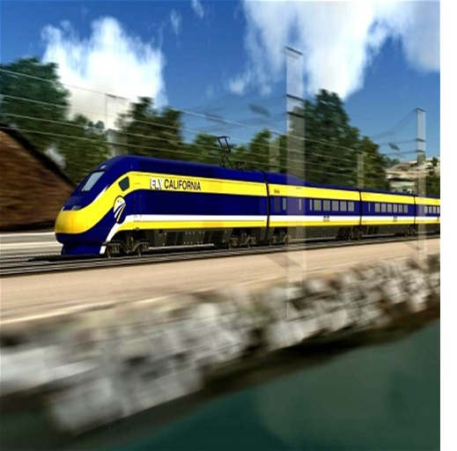
The fastest wheel of high speed Train on the digital earth
S1 : what can you see in the picture? S2 : I can see two trains in the picture
S1 : Do you know about the trains? S2 : They are speedy trains.
S1 : Do you know more about them? S2 : They can reach destination quickly.

Slide 14
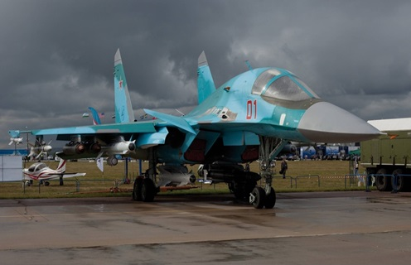
Taking off

Slide 15
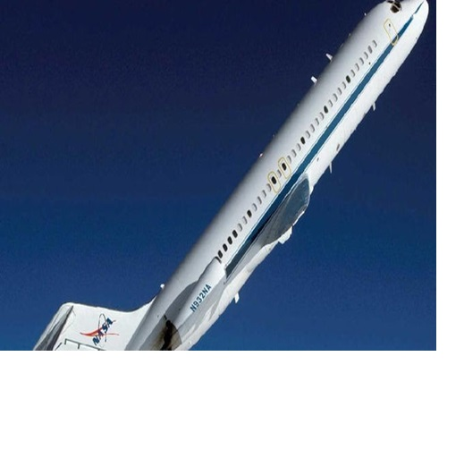
vocabulary
Supersonic Speed =These are faster than the speed of sound.

Slide 16
Group Work
Complete these statements using the correct form of words in the brackets.
Airbus 350 is a bit----------------------(slow)than Boeing 787.
Concorde flew the----------------------(fast) among all passenger aircrafts.
Even sound cannot travel as--------------(fast) as Concorde.
In supersonic speeds, Concorde flies-------------(high) in the sky than Boeing.
To many, Concorde looks---------------(beautiful) than other passenger aircrafts.
Airbus A380 is the --------------------(large) passenger aircraft in the world now.
Airbus A380can carry ---------------------(many) passengers than Boeing 787.
Slower
fastest
fast
higher
more beautiful
largest
more passengers

Slide 17
Future aircraft
Look at the pictures and say what they are. Discuss with your partner.
S1: what are they in the picture?
S2: They are planes.
S1: what kind of planes are they?
S2: They are faster.
S1: where can we see them?
S2: we can see them in the developed countries

Slide 18
Evaluation
1. What is wheel?
2. Were is Egypt ?
3. Where was Mesopotamia?
Notes:
Wheel is round when it moves running very fast.

Slide 19
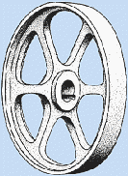
Home Work
Write a paragraph about the “Bullet Train”

Slide 20
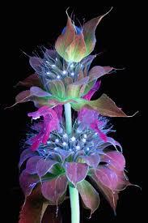
Thank you EveryBody
Notes:
Sheikh Sheikh Tajuddin Ahmed.
Senior Teacher
Hazi Ayet Ali Bhuiyan High School Khadun, Rupsi,Rupgonj, Narayangonj

